Slide 1

Smart Antenna Positioning & Alignment System with Cloud Monitoring
PROJECT SUPERVISOR
PROJECT MEMBERS
SANTHOSH D [192412209]
DR. SARAVANA KUMAR R
A.K. LIKITH CHARAN [192412305]
SANJAY ANAND[192412036]
BALAKUMAR[192412221]
MAHENTHIRAN[192412159]

Slide 2
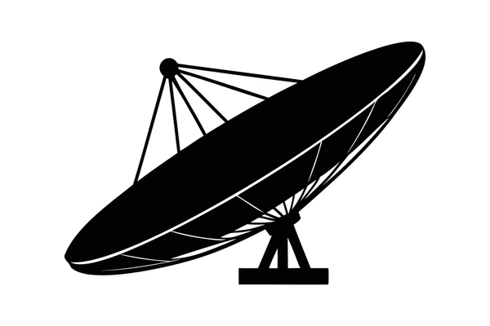
INTRODUCTION
This system adjusts the antenna direction to get the best signal strength.
Sensors and motors help the antenna move accurately without manual effort.
Data is sent to the cloud so the antenna status can be monitored .
It reduces signal loss, saves time, and improves communication quality.

Slide 3
OBJECTIVE
To design an automated mechanism that precisely controls antenna movement in horizontal and vertical directions.
To achieve accurate alignment by continuously tracking changes in antenna orientation.
To reduce human effort and errors involved in manual antenna installation and adjustment.
To enable remote supervision and control of the antenna system using cloud-based platforms..

Slide 4


System Design
Two-Way Movement: The system can move left-right and up-down smoothly.
Automatic Position Check: The system continuously checks its position for accurate movement.
Environment Monitoring: Measures temperature, humidity, and sunlight.
Mobile Control: Users can control both movements using a mobile application.
Left Side Cards
2-Axis
Moves in two directions
100%
Live monitoring and mobile control
2-Axis
Independent Azimuth & Elevation Motorized Control
100%
Real-Time Cloud Telemetry & Mobile Control Dashboard

Slide 5
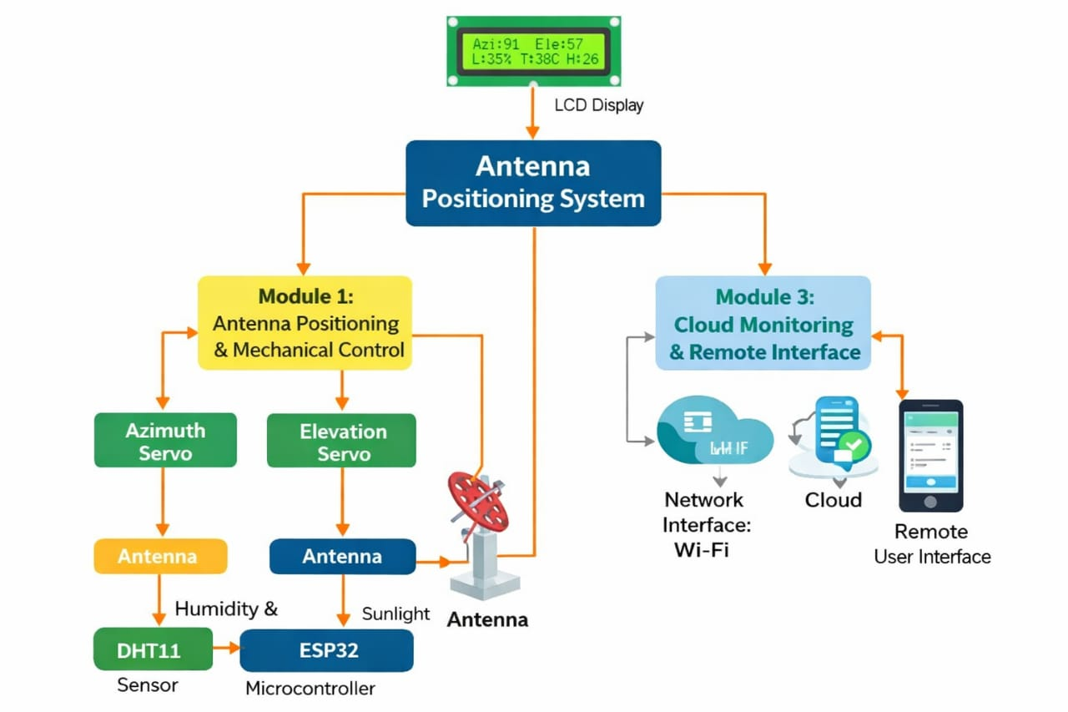
BLOCK DIAGRAM

Slide 6
MODULE 1: Mechanical Control & Actuation
✓ Horizontal Rotation (Azimuth): The base motor rotates the system from 0° to 180° in the horizontal direction.
✓ Vertical Movement (Elevation): The upper servo moves the system from 0° to 180° in the vertical direction.
✓ Strong and Stable Structure: The mounting structure is designed to handle wind and vibration without losing its position.
✓ PWM Motor Control: A 50 Hz PWM signal is used to control the motor position accurately.
✓ High Position Accuracy: The system can move in small 1° steps for precise antenna positioning.

Slide 7
MODULE 2:Sensing & Environmental Feedback Unit
Light Dependent Resistor (LDR) Array: The LDR array is used to detect the intensity of light. By comparing the intensity from different sensor positions, the system determines the direction in which the antenna needs to be adjusted.
Differential Tracking:
Suppose Left LDR = 800 , Right LDR = 500
Difference: 800 − 500 = 300
That difference tells the ESP32 that the antenna isn't perfectly aligned.
Orientation Verification: It ensures that the actual antenna position matches the required or calibrated reference position.
Temperature Range: 0°C to 50°C monitoring with ±2°C accuracy to evaluate mast thermal expansion.

Slide 8
MODULE 3:Embedded Processing & Local Display
ESP32 Processing Core
✓ Sensor Data Processing:
ESP32 reads and processes data from the connected sensors.
✓ Antenna Position Control:
ESP32 controls the servo motors to move the antenna horizontally and vertically.
LCD Display
✓ Antenna Position Display:
Shows the current horizontal (Azimuth) and vertical (Elevation) angles.
✓ Environmental Data Display:
Shows sensor values such as temperature, humidity, and light intensity.
✓ Real-Time Update:
The LCD continuously updates and displays the latest system information.
This is much more suitable for your Live Antenna Positioning System.

Slide 9
MODULE 4:Cloud Telemetry & Remote IoT GUI
IoT Communication
  ✓ Blynk IoT Connection:
  Connects the antenna positioning system to the internet for live monitoring and control.
  ✓ Real-Time Data Update:
  Continuously updates the antenna position and system data in the Blynk application.
Mobile Dashboard
  ✓ Live Antenna Control:
  Users can control the antenna movement horizontally and vertically using the blynk app.
  ✓ Position Monitoring:
  Shows the current antenna position in real time.
  ✓ Remote Access:
  Users can monitor and control the antenna from anywhere using a smartphone and internet connection.

Slide 10
MODULE 5 :Power Management & Protection Rail
Power Supply
✓ 3.3V Power Supply: Provides clean power to the ESP32 and sensors.
✓ 5V Motor Power Supply: Provides enough power for the two servo motors.
✓ Common Ground: Connects all components to the same ground for proper operation.
Protection Features
✓ Capacitors: Help maintain a stable power supply and reduce voltage drops.
✓ Overheat Protection: Protects components from damage when the system gets too hot.

Slide 11
Hardware Component Specifications
Hardware Component | Technical Specifications | Dedicated Module | System Role
ESP32 Microcontroller | Dual-Core 240 MHz, 520 KB SRAM, Wi-Fi/BLE | Module 3 & 4 | Central processing, ADC & IoT gateway
Dual Servo Motors | High torque, 50 Hz PWM, 0°–180° range | Module 1 | Azimuth and Elevation gantry actuation
Sensor Suite (LDR / DHT11) | Optical differential + 0–50°C / 20–90% RH | Module 2 | Target intensity and weather sensing
Lcd Display | HD44780 with PCF8574 backpack, 5V LED | Module 3 | On-site telemetry and angle status
Power Distribution Rail | Dual 5V / 3.3V regulated rails, 2A peak | Module 5 | Clean current supply & spike suppression

Slide 12
Applications
Satellite Communication Systems
  Aligns dish antennas to track satellites for TV, internet, or weather data reception.
  Ensures stable connectivity even when satellites move slightly in orbit.
Long‑Range Wi‑Fi Links
  Used in rural or remote areas to align directional antennas for point‑to‑point Wi‑Fi connections.
IoT Sensor Networks
  Aligns antennas in wireless sensor networks (WSN) to maximize coverage and reliability.
  Useful in smart agriculture, environmental monitoring, or industrial IoT
Drone & UAV Communication
  Mounted on ground stations to track and align with moving drones/UAVs.
  Ensures uninterrupted telemetry and video feed during flight.

Slide 13
ADVANTAGES
Real‑time control & feedback: ESP32 can continuously monitor signal strength and adjust antenna orientation dynamically for maximum reception/transmission.
Low power consumption: Compared to heavier microcontrollers or PCs, ESP32 is energy‑efficient, making it suitable for solar‑powered or battery‑operated antenna systems.
Wireless connectivity: Built‑in Wi‑Fi and Bluetooth allow remote monitoring and control via smartphone or web dashboard, eliminating the need for wired interfaces.
Easy integration with sensors & actuators: ESP32 can drive stepper motors/servos for antenna rotation and read sensors like GPS, accelerometers, or magnetometers for precise alignment.0

Slide 14
CONCLUSION
The system successfully automates antenna positioning and alignment to ensure accurate orientation.
Signal strength is improved through continuous monitoring and automatic adjustment.
Manual effort and alignment errors are significantly reduced by the automated control process.
Cloud monitoring enables remote access and real-time status updates from any location.
Overall communication reliability and system efficiency are greatly enhanced.

